Slide 1
Business Intelligence
Lecture 3

Slide 2
Lecture Agenda
Data Warehouse
Multidimensional analysis
Schemas: Star, Snowflake, Galaxy
ETL
ELT
Batch Processing

Slide 3
Data Warehouse and Multidimensional Analysis

Slide 4
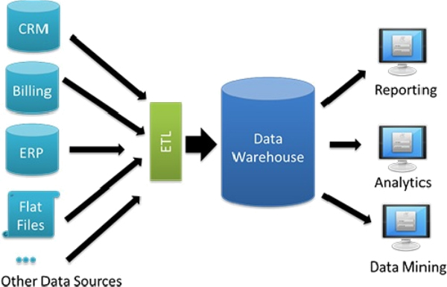
What is Data Warehouse?
“A data warehouse is a subject-oriented, integrated, time-variant, and nonvolatile collection of data in support of management’s decision-making process.”
Data warehousing: The process of constructing and using data warehouses

Slide 5
Data Warehouse
Subject Oriented
Organized around major subjects, such as customer, product, sales.
Focusing on the modeling and analysis of data for decision makers.
Time Variant
Operational database: current value data
Data warehouse data: provide information from a historical perspective
(e.g., past 5-10 years)

Slide 6
Data Warehouse
Integrated
Constructed by integrating multiple, heterogeneous data sources:
relational databases, flat files, on-line transaction records
Data cleaning and data integration techniques are applied.
Ensure consistency in naming conventions, encoding structures, attribute measures, etc.
Non-Volatile
A physically separate store of data transformed from the operational environment.
Operational update of data does not occur in the data warehouse environment.

Slide 7
Why Separate Data Warehouse?
Different functions and different data:
missing data: Decision support requires historical data which operational DBs do not typically maintain.
data consolidation: DS requires consolidation (aggregation, summarization) of data from heterogeneous sources
data quality: different sources typically use inconsistent data representations

Slide 8
Data Warehouse Back-End Tools and Utilities
Data extraction: get data from multiple, heterogeneous, and external sources
Data cleaning: detect errors in the data and rectify them when possible
Data transformation: convert data from legacy or host format to warehouse format
Load: sort, summarize, consolidate, compute views, check integrity, and build indices and partitions
Refresh: propagate the updates from the data sources to the warehouse

Slide 9
Data Warehouse Process Architecture
Centralized Process Architecture - the data is collected into single centralized storage and processed upon completion by a single machine with a huge structure in terms of memory, processor, and storage.
Distributed Process Architecture - information and its processing are allocated across data centers, and its processing is distributed across data centers, and processing of data is localized with the group of the results into centralized storage.

Slide 10
Multidimensional Modeling
A technique for structuring data around the business concepts.
ER models describe entities and relationships
Multi-dimensional models describe measures and dimensions
Measures - numerical data being tracked in business, can be analyzed and examined
Dimensions - business parameters that define a transaction

Slide 11
The Multi-Dimensional Model
Store Info
Key columns joining fact table
to dimension tables
Numerical Measures
Prod Code Time Code Store Code Sales Qty
Fact table for
measures
Product Info
Dimension tables
Time Info

Slide 12
Dimensional Modeling
Dimensions are organized into hierarchies
E.g., Time dimension: days → weeks → quarters
E.g., Product dimension: product → product line → brand
Dimensions have attributes
E.g., Time dimension: date, month, year
E.g., Store dimension: id, city, state, country

Slide 13
A Concept Hierarchy: Dimension (location)
all
all
region
Europe
...
North_America
country
Germany
...
Spain
Canada
...
Mexico
city
Frankfurt
...
Vancouver
...
Toronto
office
L. Chan
...
M. Wind

Slide 14
Data Warehouse Modeling

Slide 15
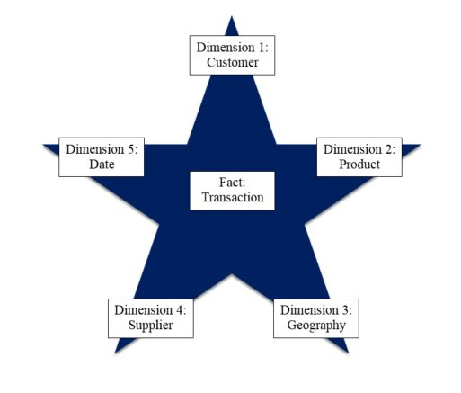
The “Classic” Star Schema
A relational model with a one-to-many relationship between dimension table and fact table.
A single fact table, with detail and summary data
Fact table primary key has only one key column per dimension
Each dimension is a single table, highly denormalized
Notes:
7
The Star is built for simplicity and speed. Forget everything you learned about designing relational databases. The Star Schema makes no excuses for the rules it breaks. The assumption behind it is that the database is static or ìquiet,î meaning that no updates are performed on-line.
Remember that most of the rules of relational database design are derived from the need to maintain atomicity, consistency and integrity (the ìACIDî test) in an On-Line Transaction Processing (OLTP) environment. Since the data warehouse is quiet, these constraints can be relaxed.

Slide 16
The “Classic” Star Schema
Benefits
Easy to understand
Intuitive mapping between the business entities
Easy to define hierarchies
Reduces number of joins
Drawbacks
Summary data in the fact table yields poorer performance for summary level
Huge dimension tables a problem
Notes:
7
The Star is built for simplicity and speed. Forget everything you learned about designing relational databases. The Star Schema makes no excuses for the rules it breaks. The assumption behind it is that the database is static or ìquiet,î meaning that no updates are performed on-line.
Remember that most of the rules of relational database design are derived from the need to maintain atomicity, consistency and integrity (the ìACIDî test) in an On-Line Transaction Processing (OLTP) environment. Since the data warehouse is quiet, these constraints can be relaxed.

Slide 17
Star Schema
time
time_key
day
day_of_the_week
month
quarter
year
item
item_key
item_name
brand
type
supplier_type
Sales Fact Table
time_key
item_key
branch_key
branch
location
location_key
branch_key
branch_name
branch_type
location_key
street
city
province_or_street
country
units_sold
dollars_sold
avg_sales
Measures

Slide 18
Families of Stars
Dimension
table
Dimension
table
Dimension
table
Fact table
Fact table
Dimension
table
Dimension
table
Fact table
Dimension
table
Dimension
table
Dimension
table

Slide 19
The Snowflake Schema
"A schema is known as a snowflake if one or more-dimension tables do not connect directly to the fact table but must join through other dimension tables.”
A snowflake schema is suitable for many to many and one to many relationships between dimension levels.
“Snowflaking” is a method of normalizing the dimension tables in a star schema.
The result is more complex queries and reduced query performance.
Notes:
7
The Star is built for simplicity and speed. Forget everything you learned about designing relational databases. The Star Schema makes no excuses for the rules it breaks. The assumption behind it is that the database is static or ìquiet,î meaning that no updates are performed on-line.
Remember that most of the rules of relational database design are derived from the need to maintain atomicity, consistency and integrity (the ìACIDî test) in an On-Line Transaction Processing (OLTP) environment. Since the data warehouse is quiet, these constraints can be relaxed.

Slide 20
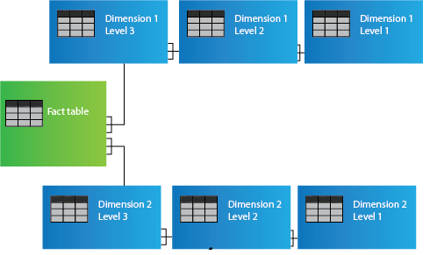
Snowflake Schema

Slide 21
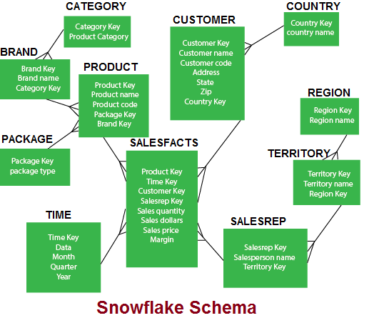
Example of Snowflake Schema

Slide 22
Snowflaking
The attributes with low cardinality in each original dimension table are removed to form separate tables. These new tables are linked back to the original dimension table through artificial keys.
Product key
Product name
Product code
Brand key
Brand key
Brand name
Category key
Category key
Product category

Slide 23
Snowflake Schema
Advantages
Small saving in storage space
Normalized structures are easier to update and maintain
Disadvantages
Schema less intuitive
Difficult to browse through the contents

Slide 24
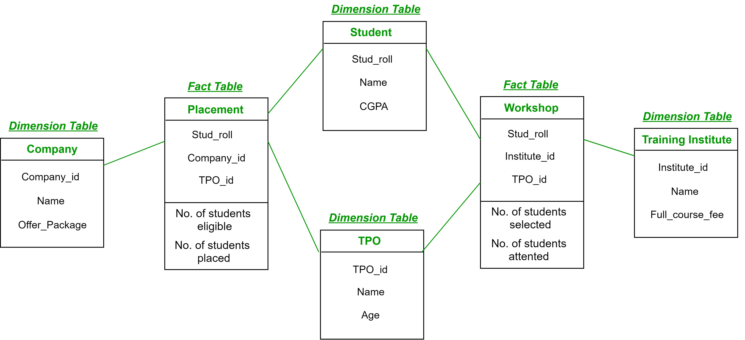
The “Fact Constellation” Schema - Galaxy
Galaxy schema - Two or more fact tables sharing one or more dimensions.
Fact Constellation Schema describes a logical structure of data warehouse or data mart.
Notes:
7
The Star is built for simplicity and speed. Forget everything you learned about designing relational databases. The Star Schema makes no excuses for the rules it breaks. The assumption behind it is that the database is static or ìquiet,î meaning that no updates are performed on-line.
Remember that most of the rules of relational database design are derived from the need to maintain atomicity, consistency and integrity (the ìACIDî test) in an On-Line Transaction Processing (OLTP) environment. Since the data warehouse is quiet, these constraints can be relaxed.

Slide 25
The “Fact Constellation” Schema
District Fact Table
District_ID
PRODUCT_KEY
PERIOD_KEY
Region Fact Table
Region_ID
PRODUCT_KEY
PERIOD_KEY
Dollars
Units
Price
Dollars
Units
Price
Notes:
10
The chart above is composed of all of the tables from the Classic Star, plus aggregated fact tables. For example, the Store dimension is formed of a hierarchy of store-> district -> region. The base fact table contains detail data by store. The District fact table contains ONLY data aggregated by district, therefor there are no records in the table with STORE_KEY matching any record for the Store dimension at the store level. Therefor, when we scan the Store dimension table, and select keys that have district = ìTexas,î they will only match STORE_KEY in the District fact table when the record is aggregated for stores in the Texas district. No double (or triple, etc.) counting is possible and the Level indicator is not needed.
These aggregated fact tables can get very complicated, though. For example, we need a District and Region fact table, but what level of detail will they contain about the product dimension? All of the following:
STORE/PROD DISTRICT/PROD REGION/PROD
STORE/BRAND DISTRICT/BRAND REGION/BRAND
STORE/MANUF DISTRICT/MANUF REGION/MANUF
And these are just the combinations from two dimensions!

Slide 26
Example of Fact Constellation
time
time_key
day
day_of_the_week
month
quarter
year
item
Shipping Fact Table
item_key
item_name
brand
type
supplier_type
Sales Fact Table
time_key
time_key
item_key
shipper_key
item_key
branch_key
from_location
branch
location_key
location
to_location
branch_key
branch_name
branch_type
units_sold
location_key
street
city
province_or_street
country
dollars_cost
dollars_sold
units_shipped
avg_sales
shipper
Measures
shipper_key
shipper_name
location_key
shipper_type

Slide 27
What is the Best Design?
Performance benchmarking can be used to determine what is the best design.
Snowflake schema easier to maintain dimension tables when dimension tables are very large (reduce overall space). It is not generally recommended in a data warehouse environment.
Star schema more effective for data cube browsing (less joins): can affect performance.

Slide 28
ETL vs ELT

Slide 29
Extract, Transform, Load - ETL
ETL process uses the pipelining concept. In this concept, as soon as the data is extracted, it can be transformed, and during the period of transformation, new data can be obtained. And when the modified data is being loaded into the data warehouse, the already extracted data can be transformed.

Slide 30
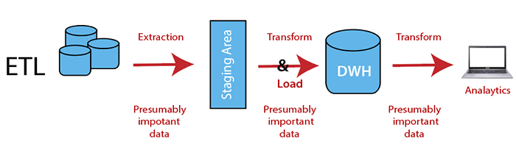
Extract, Transform, Load
Extract, Transform, and load is a process which involves extracting data from outside sources and transforming it to fit operational needs, then loading it into the target database or data warehouse. To use this approach is reasonable when we are using different database for our data warehouse.

Slide 31
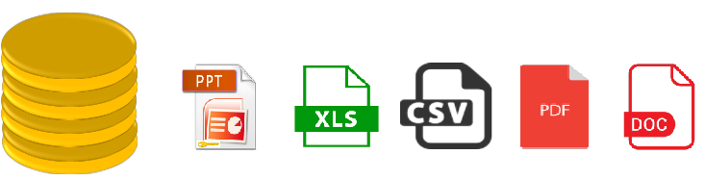
Extraction
Extraction - The main goal of extraction is to collect the data from the source system as fast as possible and less convenient for these source systems. It also states that the most applicable extraction method should be chosen for source date/time stamps, database log tables, hybrid depending on the situation.

Slide 32
Transformation
Transformation is the second step of the ETL process, where all the collected data has been transformed into the same format. It may involve the following tasks:
Filtering: Only specific attributes are loading into the data warehouse.
Cleaning: Filling up the null values with specific default values.
Joining: Join the multiple attributes into the one.
Splitting: Splitting the single attribute into multiple attributes.
Sorting: Sort the tuples based on the attributes.

Slide 33

Loading
Loading is the final step of the ETL process.
The big chunk of data is collected from various sources, transformed them,
and finally loaded to the data warehouse.

Slide 34
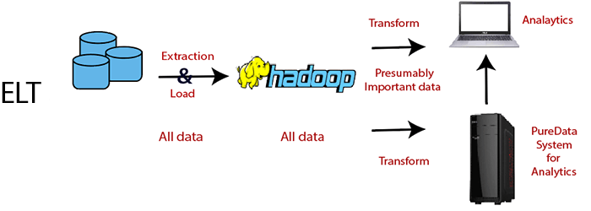
Extract, Load, Transform - ELT
In the ELT approach, after extracting the data, we immediately start loading phase, moving all the data sources into a single, centralized data repository. With today's infrastructure technologies are using the cloud, and systems can now support large storage and scalable compute.

Slide 35
Extract, Load, Transform - ELT
The ELT approach provides a modern alternative to ETL,
but there are cases when we need to use ELT:
When the volume of data is high.
When the source database and target database both are same.

Slide 36
Working of ELT
Extract: Extract the data from different data source which work similar in both data management approaches.
Load: ELT delivers the whole data to the site where it will live. ELT shortens the cycle between the extraction and delivery, but there is a lot of work which should be done before the data becomes useful.
Transform: Here, data warehouse and database sorts and normalize the data. The overhead for storing this data is high, but it comes with more opportunities.

Slide 37
Differences between ETL and ELT
Parameter | ETL | ELT
Process | Data is transferred in staging server and then moved to Data Warehouse Database. | Data remains in the DB of the data warehouse.
Code Usage | Small amount of data | Huge data
Transformation-Time | Needs time for transformation completion. | Speed never depends on the size of the data

Slide 38
Differences between ETL and ELT
Parameter | ETL | ELT
Maintenance-Time | High maintenance - select the data to load and transform | Low maintenance - the data is available all the time
Implementation Complexity | Easier to implement it at an early stage | To implement the ELT process organization should have in-depth knowledge of expert skills and tools
Cost | High for small and medium business | Low entry costs using SaaS

Slide 39
Differences between ETL and ELT
Parameter | ETL | ELT
Complexity | Loads only the essential data, which is identified at design time | Online backward and loading only relevant data
LookUps | Dimension and facts need to be available in the staging area | All data will be available because extract and load occur in one single action
Calculations | Need to override the existing column by update values | Easy to add the column to the existing table
Unstructured Data | Supports relational data | Supports unstructured data

Slide 40
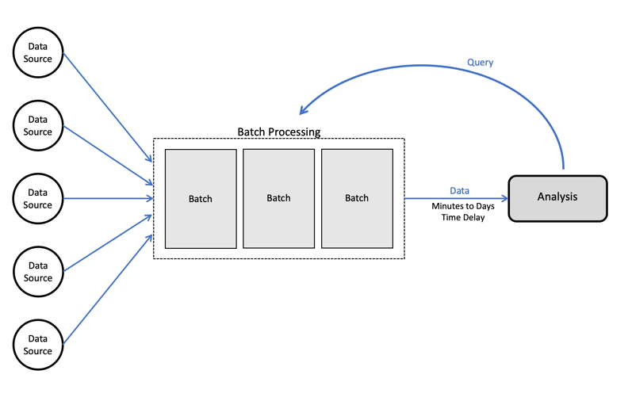
Building an ETL Pipeline – Batch Processing
Transfer and process the data in batches from the source database to the data warehouse. It is challenging to develop an enterprise ETL Pipeline.

Slide 41
Building an ETL Pipeline – Batch Processing
Step 1: Reference Data
Here, we will create a set of data that defines the set of permissible values and may contain the data.
Example: In a country data field, we can define the country codes which are allowed.
Step 2: Extract from Data Reference
Most of the ETL systems combine the data from multiple source systems, including relational database, non-relational database, XML, JSON, CSV files and after successful extraction.
Data is converted into a single format for standardizing the format.

Slide 42
Building an ETL Pipeline – Batch Processing
Step 3: Data Validation
An automated process confirms whether the pulled data from sources have expected values. Example:
A data field should contain valid dates within the past 12 months in a database of financial transaction from the past year.
The validation engine rejects the data if it fails the validation rules.
We analyze the rejected records, on a regular basis, to identify what went wrong.
Here we correct the source data or modify extracted data to resolve the problem in the next batches.

Slide 43
Building an ETL Pipeline – Batch Processing
Step 4: Transform Data
Removing extraneous or erroneous data
Applying business rules
Checking data integrity (ensuring that data was not corrupted by ETL)
We need to program and test a series of rules or functions that can achieve the required transformation and run them on the extracted data.
Example: if we analyze revenue, we can summarize the dollar amount of invoices into a daily or monthly total.

Slide 44
Building an ETL Pipeline – Batch Processing
Step 5: Stage
Data should be entered first into a staging database
Making it easier to roll back if something goes wrong.
Step 6: Publish to Data Warehouse
Loading the data to the target tables.
Some data warehouse overwrites existing information every time, the ETL pipeline loads a new batch daily, monthly or weekly.

